Slide 1

“Going Head-to-Head
with Hypocrisy ”
2:11 – 21
Week 5
16 February 2022

Slide 2


Slide 3

Galatians Ch2 Overview
As Paul continues defending his apostleship, he describes a meeting in Jerusalem fourteen years after his conversion (AD 35 + 14 years = AD 49). It was prompted by divine revelation, and Barnabas and Titus went with him to meet “those who were of reputation” (Peter, John, and James [Jesus’ brother]). This is the Jerusalem Council immediately following the first missionary journey from AD 47 to early 49 (2:1-2).
The meeting was private, but some false brethren were secretly brought in who sought to demand that Titus, a Gentile, be circumcised. Paul refused, viewing it as an effort to bring them back into bondage from which Christ set them free (2:3-5).

Slide 4
Galatians Ch2 Overview
The result of the meeting was that “those who seemed to be something” added nothing to Paul’s gospel. In fact, once they saw that the gospel of the uncircumcised had been given to him just as the gospel of the circumcised had been given to Peter, and once James, Cephas, and John perceived the grace that had been given to Paul, he was extended the right hand of fellowship (2:6-9).
They only asked that Paul be mindful of the poor, something he was very eager to do (2:10).

Slide 5
Galatians Ch2 Overview
The rest of the chapter describes a confrontation in Antioch between Peter and Paul. Peter, who was visiting at first was willing to eat with the Gentiles, but when some Jewish Christians came from James (that is Jerusalem). Out of fear, Peter withdrew himself from eating with Gentiles. Through Peter’s influence, the rest of the Jews, even Barnabas, withdrew from the Gentiles and were carried away into hypocrisy (2:11-13).
This prompted Paul to withstand Peter “to his face,” and to rebuke him in the presence of all. In the course of his rebuke, Paul stressed that we are justified by faith in Christ, and not by the works of the law, otherwise Christ died in vain (2:12-21).

Slide 6

Going Head-to-Head
with Hypocrisy

Slide 7
Galatians
Background:
If there’s one thing we can’t seem to do without, it’s privacy. Nobody likes strangers wandering around in their yards or snoops peeking through their windows. Nobody wants even their close friends rifling through their closets or searching through their drawers.
Most of all, nobody relishes the idea of exposing the depths of their family dysfunctions or the details of household squabbles. Everything in us wants to protect our families from poking and our personal lives from probing.

Slide 8
Galatians
Background:
This fact makes Galatians 2:11-21 all the more surprising. As Paul builds his argument against the legalistic Judaizers’ twisted gospel, he crosses into the uncomfortable realm of family wrangling.
Instead of keeping this particular episode of church conflict a secret, Paul exposes the details of is brief but fierce confrontation with the apostle Peter himself.
He doesn’t do this to simply hang out the church’s dirty laundry or to meet some ideal of “total transparency.” Paul knows like anybody else that not everything should be broadcast to the public.

Slide 9
Galatians
Background:
Furthermore, Paul certainly isn’t trying to hang Peter out to dry. We saw in the last section that Peter and the Jerusalem apostles had given Paul and Barnabas the “right hand of fellowship” (2:9). Peter and Paul agreed on their theology and had mutually affirmed each other’s ministries—to Jews and Gentiles, respectively. They were colleagues, not competitors. Each respected the other.
So, what motivated Paul to report his conflict with Peter to the troubled churches in Galatia?

Slide 10
Galatians 2:11 – 14
¹¹When Cephas came to Antioch, I opposed him to his face, because he stood condemned. ¹²For before certain men came from James, he used to eat with the Gentiles. But when they arrived, he began to draw back and separate himself from the Gentiles because he was afraid of those who belonged to the circumcision group. ¹³The other Jews joined him in his hypocrisy, so that by their hypocrisy even Barnabas was led astray. ¹⁴When I saw that they were not acting in line with the truth of the gospel, I said to Cephas in front of them all, “You are a Jew, yet you live like a Gentile and not like a Jew. How is it, then, that you force Gentiles to follow Jewish customs?

Slide 11
Galatians 2:11 – 14
When Peter arrived in Antioch some time after the events of Ch 2:1-10, his actions openly contradicted his doctrine. Yes, Paul and Peter had agreed on the implications of the gospel while in Jerusalem, but Peter was “not straightforward about the truth of the gospel” when he faced peer pressure from Jewish Christians (2:14).
In response to Peter’s display of hypocrisy, Paul confronted him face-to-face. Paul included an account of this event in the letter to the Galatians in order to leave no doubt that he preached the true gospel and possessed the authority to uphold it—even if it meant rebuking the apostle Peter. This is why, when Peter played the hypocrite in Antioch, Paul “opposed him to his face,” pointing out his inconsistency in from of everybody (2:11).

Slide 12
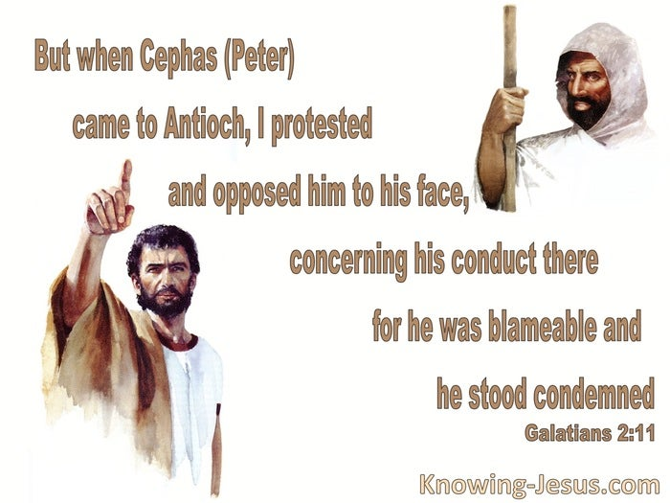

Slide 13
Galatians 2:11 – 14
What specifically did Peter do to draw Paul’s ire? Simply put, Peter flip-flopped in his attitude and actions toward the Gentiles of Antioch when some Jewish hard-liners from Jerusalem showed up. Paul tells the Galatians that when Peter first arrived in that city, where the Gentile mission was exploding, Peter would enjoy uninhibited fellowship with the Gentiles around common table.
This mark of fellowship would have been forbidden under the Jewish interpretation of the Law. Eating with unclean Gentiles meant eating their non-kosher food, something a good, Law-abiding Jew would never do. But Peter’s vision of the unclean animals and the subsequent unconditional conversion of the Roman centurion Cornelius (Acts 10) had convinced him

Slide 14
Galatians 2:11 – 14
But Peter’s vision of the unclean animals and the subsequent unconditional conversion of the Roman centurion Cornelius (Acts 10) had convinced him that the Law had been supplanted by the gospel, that legalism should be demolished by grace. So, rather than separating himself from the Gentile believers, Peter enjoyed a meal with them.
Until . . . Representatives from the Jerusalem church arrived in Antioch. Remember that controversy and confusion about following the Law still raged in Jerusalem, so when Jewish Christians showed up in Antioch, they brought those tensions with them. Paul describes these visitors as “certain men from James” (2:12).

Slide 15
Galatians 2:11 – 14
Now, James had been in full agreement with Paul and Barnabas while they were in Jerusalem, but he was famous for following the Law to a tee as a testimony to unbelieving Jews, a principle even Paul later advocated (1Cor 9:20). They obeyed the Law not to be saved or sanctified, but to adapt to the culture in which they lived in order to keep from putting a stumbling block before the Jews.
But what do those same Law-abiding Jews do when they leave that Jewish cultural context? Until the Jewish Christians from Jerusalem arrived, Peter had answered that question by eating with the Gentiles in Antioch. When a number of his Jewish friends showed up; however, he reverted to his old ways.

Slide 16
Galatians 2:11 – 14
Paul reports that Peter withdrew from the Gentiles and held himself aloof because he feared the “party of the circumcision” (2:12). Many find it striking that Peter, who was well known for his boldness in the face of opposition, would behave hypocritically in Antioch for fear of the legalistic Judaizers. But when we retrace the steps that led from Paul’s relief visit to Jerusalem (2:1-10; Acts 11:27-30) to Peter’s hypocrisy in Antioch, we begin to understand the pressures that had come to bear on that otherwise-stalwart apostle.
At the same time Paul, Barnabas, and the uncircumcised Titus came to bring famine relief to those in Jerusalem, a violent persecution broke out in Jerusalem at the hands of Herod Agrippa I, grandson of Herod the Great (Acts 12:1).

Slide 17
Galatians 2:11 – 14
In this attack, Herod executed James, one of the original twelve apostles and the brother of John (Acts 12:2). The Jewish religious leaders, likely thrilled that their attempts at destroying the church had gained governmental backing, praised Herod for his nationalism. This only encouraged him to continue further persecution.
As a result, Peter himself was hunted down and thrown in prison (Acts 12:3-4). While the Jews were likely plotting to have Peter executed, as they had done several years earlier with Jesus, an angel of God conducted a covert rescue mission, miraculously releasing Peter right from under the guards’ noses (Acts 12:6-18).

Slide 18
Galatians 2:11 – 14
Shortly after these occurrences, Paul and Barnabas returned to Antioch with John Mark (Acts 12:25). From there the church in Antioch sent them on the first missionary journey (Acts 13:1-3).
This brings us to the time of the clash between Paul and Peter. We are told that Paul and Barnabas remained for some time in Antioch (Acts 14:28). Peter most likely paid his visit to Antioch during this time, both to hear the report of the missionary journey and to visit with his old friends, Paul and Barnabas. But we are also told that at about the same time, or shortly thereafter, “some men came down from Judea and began teaching the brethren, ‘Unless you are circumcised according to the custom of Moses, you cannot be saved’” (Acts 15:1).

Slide 19
Galatians 2:11 – 14
It’s important to point out that Peter did not himself belong to this group, which Paul calls “the party of the circumcision” (2:12). Rather, Peter may have been carried off into hypocritical behavior simply because he was trying to avoid another outbreak of persecution against the already brutalized church in his hometown.
In Jerusalem, following the Law was an attempt to win unbelieving Jews. Early historical testimony suggests that James, the brother of Jesus, was known among Jews in Jerusalem as “the Just” because of the unimpeachable devotion he exhibited among the Jewish people.

Slide 20
Galatians 2:11 – 14
So, for the Jewish Christians in Jerusalem, following the Law was necessary to avoid putting a stumbling block in the way of their unbelieving Jewish friends and family. In Antioch, however, following the Law would have meant excluding the Gentiles believers. Such unloving legalism would have alienated and confused them. Worst yet, it would have unwittingly lent credence to the festering Judaizing heresy that insisted, “Unless you are circumcised... You cannot be saved” (Acts 15:1).
So magnetic was the pull toward hypocrisy that all the Jewish believers in Antioch followed Peter’s lead. We can hear Paul’s disappointment when he has to admit, “Even Barnabas was carried away by their hypocrisy” (2:13).

Slide 21
Galatians 2:11 – 14
The Greek term for hypocrisy means “play-acting, pretending, wearing a disguise (mask).” Pete and Barnabas believed one thing but did another.
What we Paul to do? Would he just sit back and watch as Peter led a brigade of Jewish Christians who acted like they were deserting the gospel? Not for a second! Instead, when he saw that Peter was acting in a way that was inconsistent with what he believed, Paul boldly confronted Peter in the presence of everybody—Jews and Gentiles (2:14).

Slide 22
Galatians 2:11 – 14
Paul’s Rebuke of Peter (2:14)
When Paul observed the inconsistency between Peter’s faith and his practice, he pounced. Paul began by abruptly pointing out the obvious inconsistency. This must have caused both discomfort and embarrassment for Peter and his companions—and probably anger among the smaller band of fuming Judaizers present among them.
Paul pointed out that not long ago Peter had lived like the Gentiles, observing their customs, speaking their language, and eating their foods.

Slide 23
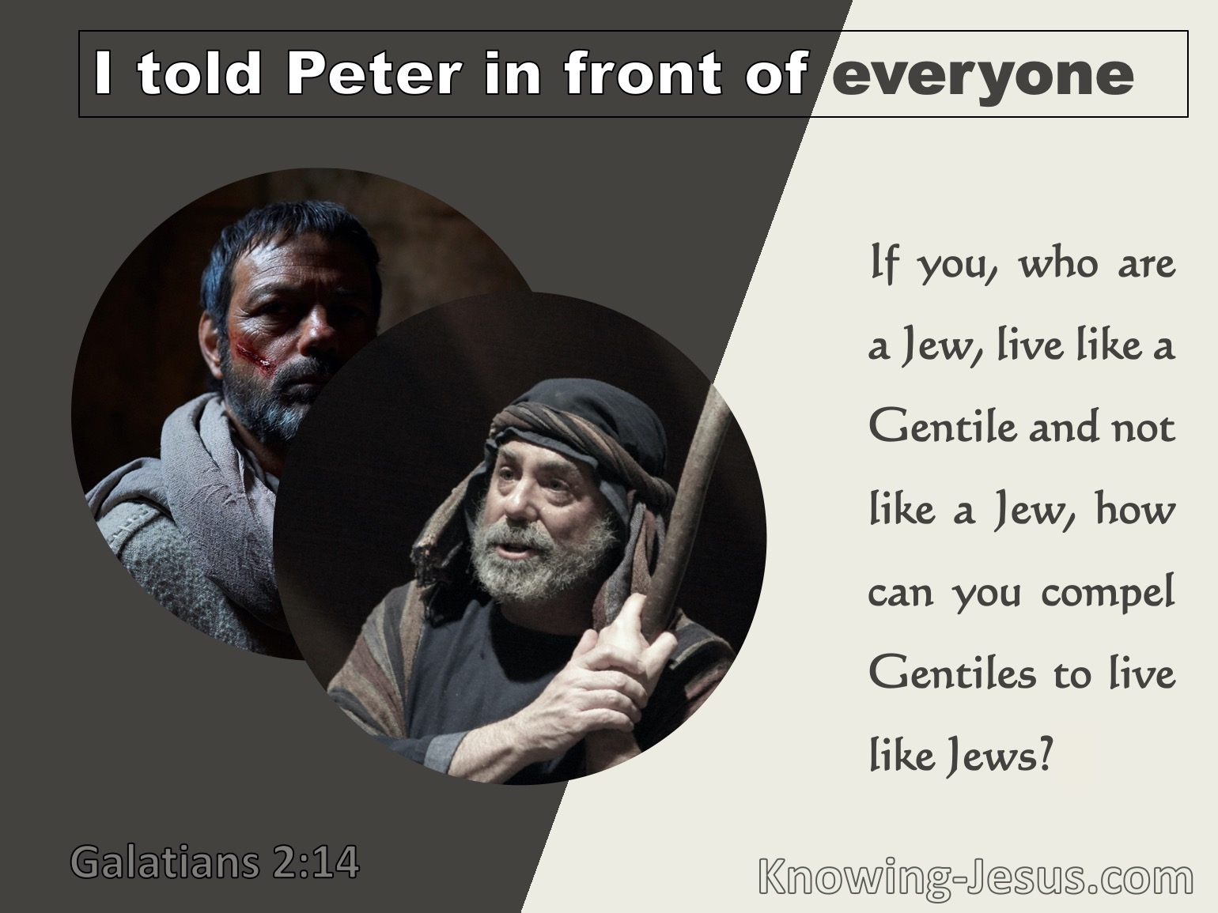

Slide 24
Galatians 2:11 – 14
Paul’s Rebuke of Peter (2:14)
Yet now Peter’s actions appeared to communicate a lie. In order to have Christian fellowship with the Jerusalem visitors, the Gentiles would have to live like Jews.
Once Paul brought the issue out of the gray shadows and into the light, everybody in the room would have noticed the stark contrast . . . and recognized Peter’s blatant hypocrisy.

Slide 25
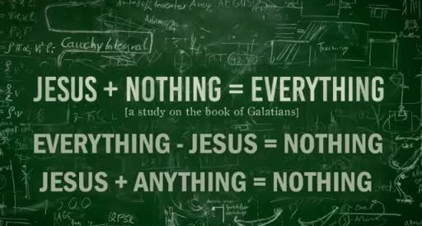

Slide 26
Galatians 2:15 – 18
¹⁵“We who are Jews by birth and not sinful Gentiles ¹⁶know that a person is not justified by the works of the law, but by faith in Jesus Christ. So we, too, have put our faith in Christ Jesus that we may be justified by faith in Christ and not by the works of the law, because by the works of the law no one will be justified. ¹⁷“But if, in seeking to be justified in Christ, we Jews find ourselves also among the sinners, doesn’t that mean that Christ promotes sin? Absolutely not! ¹⁸If I rebuild what I destroyed, then I really would be a lawbreaker.

Slide 27
Galatians 2:15 – 18
Paul’s Review of Justification by Grace Alone (2:15-16)
Paul then reviews the same gospel that Peter, Barnabas, and the others had already affirmed long ago—the very basis for their “right hand of fellowship” and mutual support of each other’s ministries (2:9).
Paul’s main point in 2:15-16 is summed up by this simple truth: Even those who were born Jewish know they could not be saved by keeping the Law, but only by faith in Jesus Christ.
Paul emphasizes several vital theological truths in this restatement of the gospel of salvation by grace alone through faith alone in Christ alone.

Slide 28
Galatians 2:15 – 18
Paul’s Review of Justification by Grace Alone (2:15-16)
The bottom line is that sinners are declared righteous (justified) by God through faith in Christ, not by keeping the Law. In fact, it is quite impossible for the Law to save anybody, even the most righteous, Law-loving Jew.
Therefore, why capitulate to a group of so-called Christians who separate themselves from genuine believers over keeping the Law?

Slide 29
Galatians 2:15 – 18
Paul’s Rejection of the Charge of License (2:17-18)
By exposing Peter’s hypocrisy, Paul confirmed the truth of the gospel based on his obvious apostolic authority. But his answer, which emphasized grace and faith apart from works of the Law, led to another question. No doubt the Judaizing false teachers in both Antioch and Galatia were making the same reasonable argument against Paul’s insistence on grace. Too much emphasis on grace will make Christ a minister of sin!
That is, if a believer in Christ does not need to keep the Law in any fashion, then logically this would mean that justified sinners can continue in sin with no repercussion!

Slide 30
Galatians 2:15 – 18
Paul’s Rejection of the Charge of License (2:17-18)
By exposing Peter’s hypocrisy, Paul confirmed the truth of the gospel based on his obvious apostolic authority. But his answer, which emphasized grace and faith apart from works of the Law, led to another question. No doubt the Judaizing false teachers in both Antioch and Galatia were making the same reasonable argument against Paul’s insistence on grace. Too much emphasis on grace will make Christ a minister of sin!
That is, if a believer in Christ does not need to keep the Law in any fashion, then logically this would mean that justified sinners can continue in sin with no repercussion!

Slide 31
Galatians 2:15 – 18
Paul’s Rejection of the Charge of License (2:17-18)
In fact, the more we sin, the more “grace” we get to cover those sins. If this is God’s way of salvation, then it makes God an advocate of sin. So Paul posses the question: “If in seeking to be justified in Christ, we Jews find ourselves also among the sinners, doesn’t that mean that Christ promotes sin? God forbid!” (2:17).
Paul’s opponents thought that people who disregarded the Law and its righteous works would be “found sinners.” Since Christ is the One who supplies this grace that leads to lawlessness, He would actually be enabling a sinful lifestyle.

Slide 32
Galatians 2:15 – 18
Paul’s Rejection of the Charge of License (2:17-18)
Is this a valid conclusion to draw from the gospel’s message of salvation by grace through faith plus nothing? It seems reasonable, doesn’t it? Based on human logic, what else could we conclude?
Yet Paul categorically and unequivocally rejects that line of thinking with the strongest negative one can utter in the Greek language: “May it never be!” In fact, Paul turns the argument around on his hearers. Before salvation by grace through faith in Christ, the Law served only to separate Gentiles from the people of God and to condemn us from our sinfulness.

Slide 33
Galatians 2:15 – 18
Paul’s Rejection of the Charge of License (2:17-18)
None of us can keep the Law perfectly—neither Jew nor Gentile. As the apostle James himself wrote to Jewish believers, “For whoever keeps the whole law and yet stumbles in one point, he has become guilty of all” (James 2:10).
Even James himself shows that the Law is a means of condemning, not saving—of demonstrating our sinfulness, not making us more righteous. Paul explains, only the cross of Christ can give us the assurance we need to step out in faith and live a truly grace-filled life.

Slide 34
Galatians 2:19 – 21
¹⁹“For through the law I died to the law so that I might live for God. ²⁰I have been crucified with Christ and I no longer live, but Christ lives in me. The life I now live in the body, I live by faith in the Son of God, who loved me and gave himself for me. ²¹I do not set aside the grace of God, for if righteousness could be gained through the law, Christ died for nothing!”

Slide 35
Galatians 2:19 – 21
Paul’s Rejection on the Exchanged Life (2:19-20)
Paul applies the image of death and resurrection to help explain his old relationship to the Law and his new relationship with Christ. Far from being a pathway to life, the Law showed Paul his sinfulness, leading him to the true Way—Jesus Christ.
“Through the Law” Paul realized his own unfitness fro the kingdom and was driven to the gospel, which is the end of the Law. Having died to his obligation to keep the Law in order to gain righteousness, Paul was not left for dead. Instead, he was made alive to God, enjoying a direct, personal, intimate relationship with the Lawgiver Himself (2:19).

Slide 36
Galatians 2:19 – 21
Paul’s Rejection on the Exchanged Life (2:19-20)
Having stopped trying to please God by keeping the Law, Paul exchanged his damning pursuit of self-righteousness for the life-giving grace of Jesus Christ. The death Christ died was reckoned to him, and he therefore died to the old life and was raised together with Christ to a new life.
How can we receive this new life? Ironically, it comes when we die with Christ—when, by faith, we enter into a personal and spiritual relationship with Him that is so intimate that God regards our sinful selves as crucified with Him.

Slide 37
Galatians 2:19 – 21
Paul’s Rejection on the Exchanged Life (2:19-20)
Then, just as Christ was raised from the dead, we too are reborn with Christ living in us (2:20). In this born-again state, we live the exchange life on the spiritual level. We give ourselves to Christ and He gives Himself to us, empowering us with His infinite strength so we can live as He desire.
This is not lawless living! This is a freedom that transcends the dos and don’ts of legalism and releases us to a life of true love, devotion, and faithfulness.

Slide 38


Slide 39
Galatians 2:19 – 21
Paul’s Return to the Central Issue (2:21)
The Christian life is not about working as hard as we can to live right; it’s about allowing Christ Himself to live out His life through us. As that happens, Christ’s character and glory are displayed in us for all to see. Unlike the Judaizers’ anti-grace message, Paul’s gospel does not “nullify the grace of God” (2:21).
By seeking either to obtain or to maintain righteousness by human effort, the Judaizers rejected the grace of God. For if sinful people can obtain their own salvation by keeping the Law, then “Christ died needlessly” (2:21). His death was a waste, His precious blood spilled in vain!

Slide 40
Galatians 2:19 – 21
Paul’s Return to the Central Issue (2:21)
If anyone insist that our righteousness comes by works or that we earn our salvation through our own efforts, that person is saying, in effect, that Christ died needlessly. Similarly, if anyone believers that we keep our salvation by doing good works, somehow contributing to the work of Christ—meeting Him halfway—that individual regards the full and finished work of Christ on the cross as partial and incomplete.
No, our justification, sanctification, and future glorification are all results of God’s grace alone . . . effected through faith alone in the finish work of Christ alone. In short, grace is the way to life and the way of life.

Slide 41

HEALING HYPOCRISY
Application: Chapter 2:11 – 21

Slide 42
Galatians 2:11 – 21
Healing Hypocrisy
[1] – Christians are accountable to one another.
  We can’t live as we please and expect everyone else to look the other way. God’s standard of living applies to us all, and we need to help one another maintain it—even if it involves private or public confrontation.
  But the rebukes we give should be offered with genuine love and concern for those who falter (Ps 141:5; Prov 27:6). When we hold others accountable to a life of integrity—and invite others to do the same for us—we can heal hypocrisy.

Slide 43
Galatians 2:11 – 21
Healing Hypocrisy
[2] – Christians impact others.
  As Christians, we represent Christ to a watching world—for better or worse. Whether or not people actually model their lives after ours, we are affecting their attitudes toward Christ and influencing their decisions and action.
  We need to live lives in conformity with what we believe and teach, knowing that even a whiff of hypocrisy can cause unbelievers to turn away from Christianity in disgust.

Slide 44
Galatians 2:11 – 21
Healing Hypocrisy
[3] – Christians should be committed to the truth.
  God is the God of truth (Isa. 65:16). Jesus is the way, the truth, and the life (John 14:6). And the Holy Spirit guides believers into the truth. When we claim to be children of God but live in ways that deny that claim, we’re not living in keeping with the truth.
  In fact, 1John 3:18 says, “Let us not love with word or with tongue, but in deed and truth.” Of all people, Christians should be known for our unwavering commitment to all that is true and right, demonstrated in both our private and public lives.

Slide 45

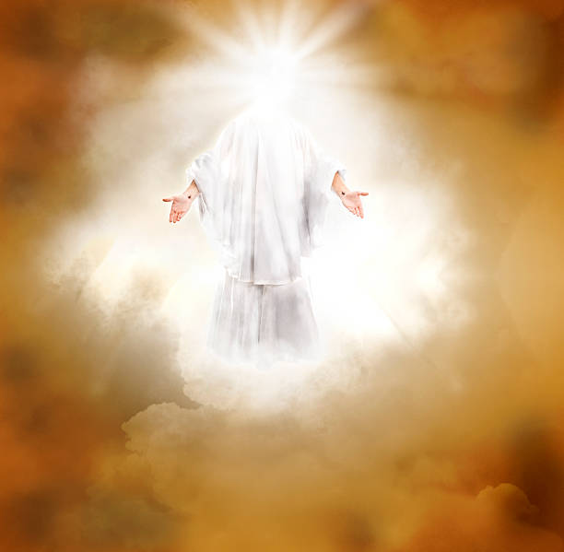

Slide 46
NEXT CLASS – 23 Feb 2022
Book of Galatians
Before next class, read the below verses in the KJV and the NIV, plus one additional versions of the Bible, i.e., NRSV, NLT, NKJV, etc …
Chapter 3:1 – 14
“Backsliding into Legalism”
EBC Website for Handouts
https://bit.ly/surveyofpaulineepistles

